Slide 1
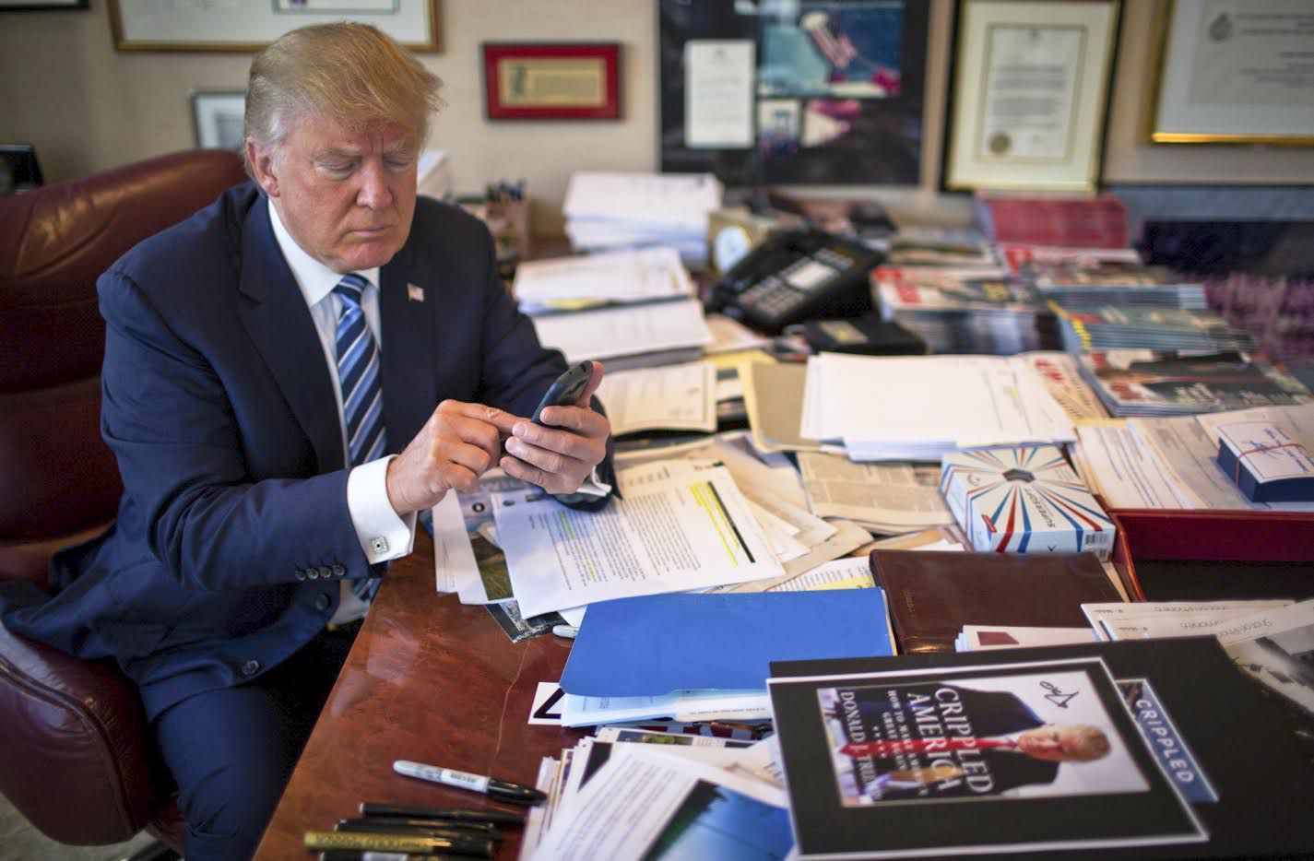

Popular Tweet Times of Donald J. Trump and Common Rhetoric
Adrian Sandoval-Vargas

Slide 2
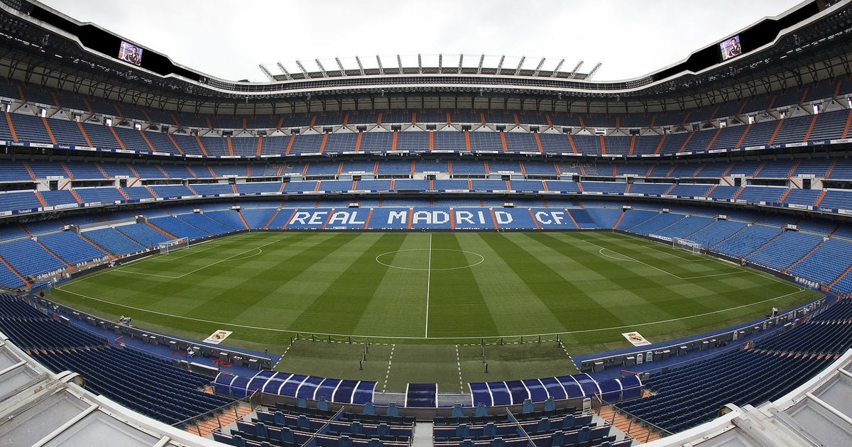
Popular Players in European Football
Adrian Sandoval-Vargas

Slide 3






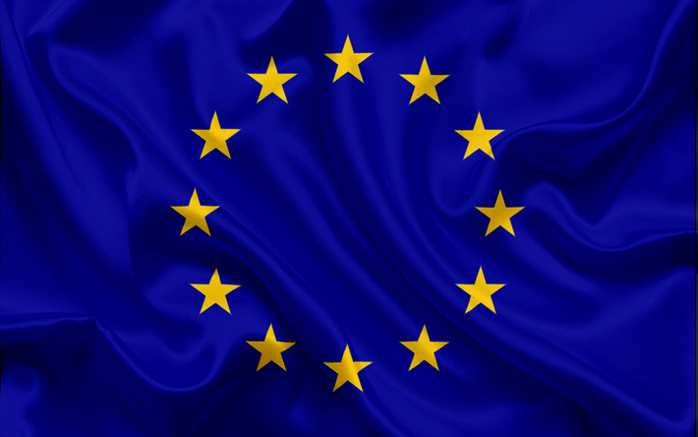
Leagues

Slide 4
Data
Fetching
@LaLiga, @premierleague, @Championsleague
Twitter
Limits ~3,234 tweets
Top Tweeters
Premier league (9/12/2019 – 12/04/2019)
La Liga (8/25/2019 – 12/04/2019)
Champions League (5/7/2019 – 12/04/2019)

Slide 5
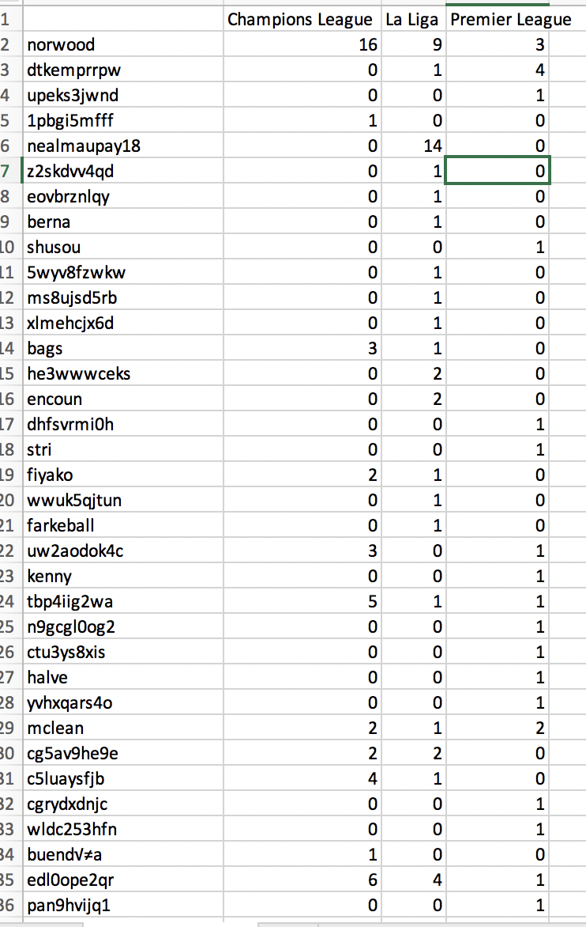
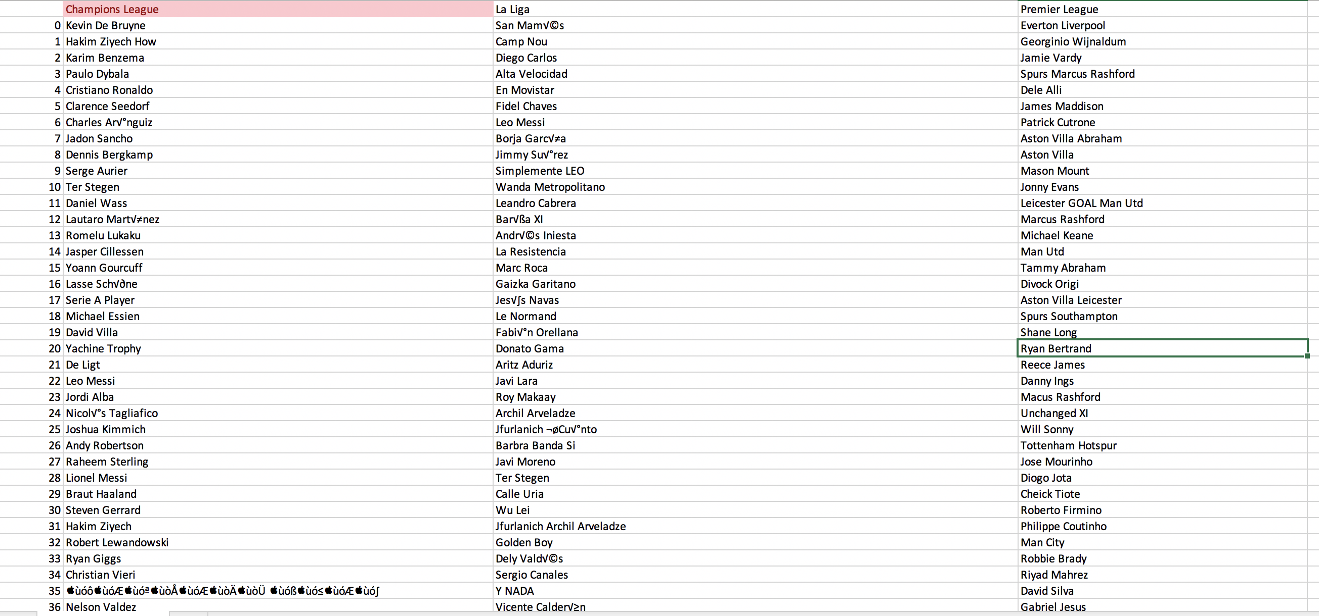
Data

Slide 6

Back To Donald J. Trump
Fetching
@realDonaldTrump
Twitter
158 Tweets (idk why it limits me, National Security?)
No Retweets

Slide 7
Tools
Tweepy
Library to fetch api calls to twitter
Standard python data processing libraries (nltk, sklearn)

Slide 8
Data
Extracted in utf-8
For handling need to decode back to ascii
Date and Time depend on location
Date text 0 2019-12-05 03:50:35 ....”I would like to have the Attorney General... 1 2019-12-05 03:50:35 When I said, in my phone call to the President... 2 2019-12-05 00:03:14 Just read the best Maureen Dowd column, in the... 3 2019-12-04 22:43:19 .@NATO has now recognized SPACE as an operatio... 4 2019-12-04 22:36:31 The Fake News Media is doing everything possib... .. ... ... 154 2019-11-20 19:04:30 I WANT NOTHING! https://t.co/KKUfwSIRAi 155 2019-11-20 18:57:07 ....”I WANT NOTHING! I WANT NOTHING! I WANT NO... 156 2019-11-20 18:57:06 Impeachment Witch Hunt is now OVER! Ambassador... 157 2019-11-20 18:45:36 We join families of Kevin King &amp; Tim Weeks... 158 2019-11-20 18:03:40 https://t.co/HbgEgZsPZ9

Slide 9
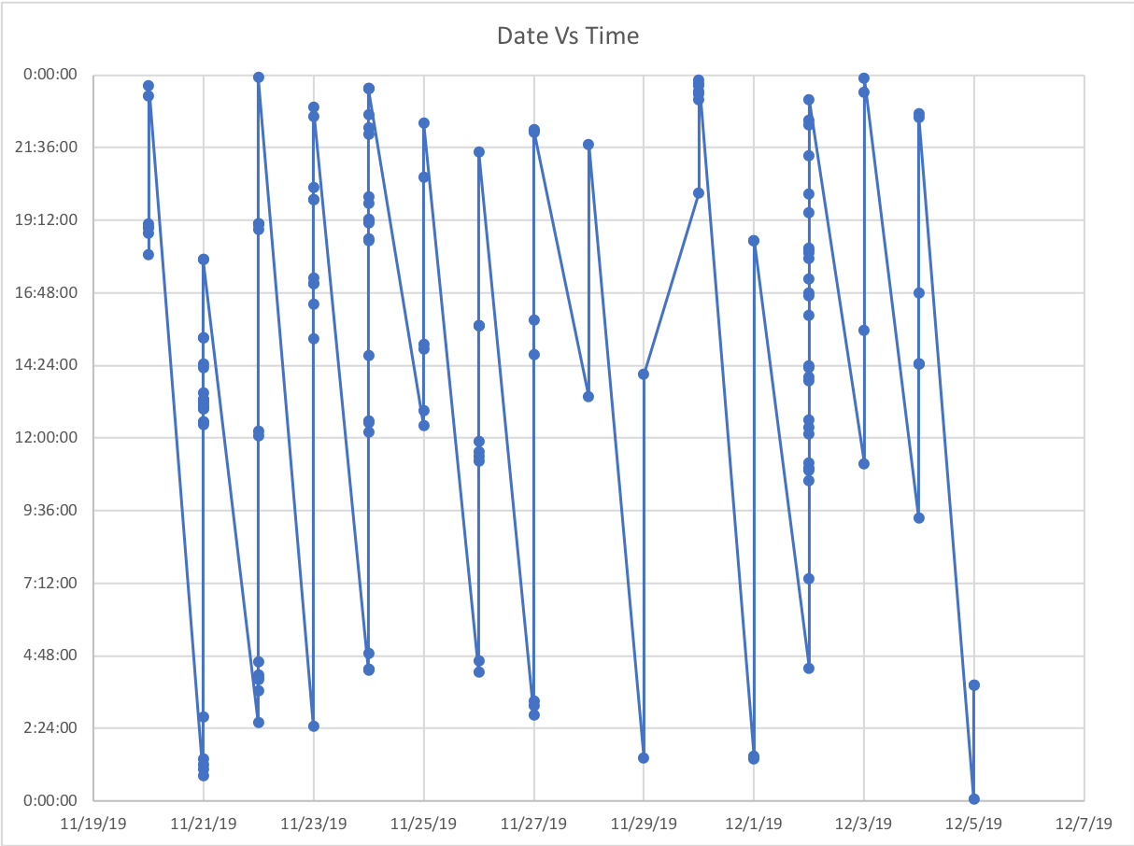
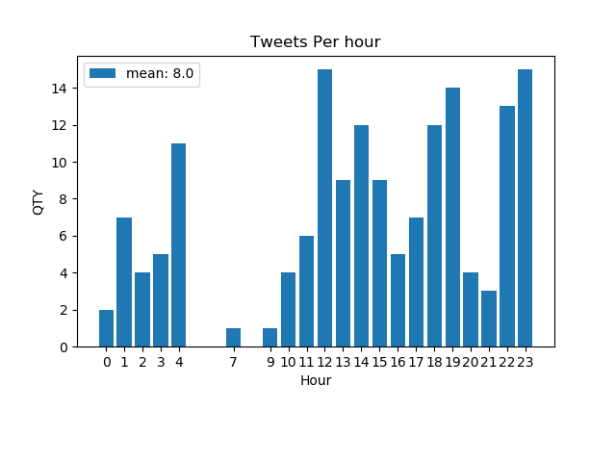
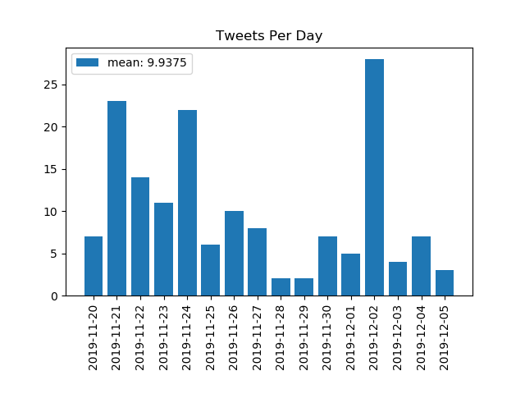
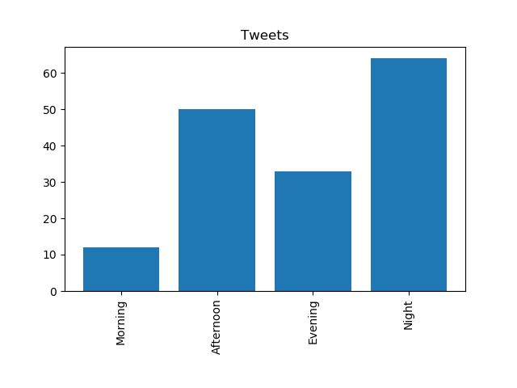
Data - Time
What kept him tweeting almost all day?

Slide 10
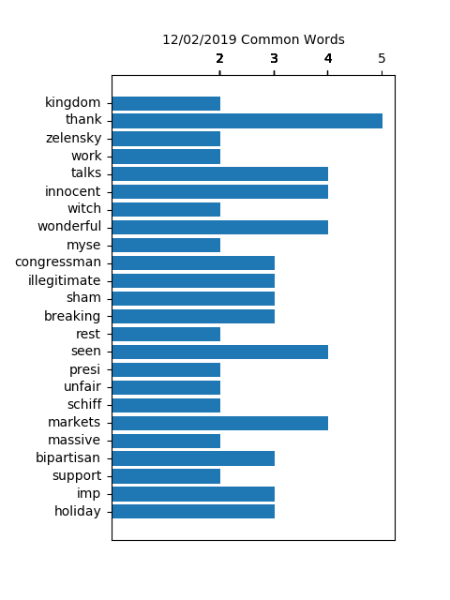
Data - Rhetoric
cline4virginia,1
remarks,1
morning,1
illegitimate,3
hoa,1
wcmmi7q7q2,1
europe,1
represent,1
country,1
fight,1
hard,1
american,1
people,1
pu,1
gekugvw7sj,1
constitutional,1
lawyers,1
need,1
6xh3iq7bsk,1
law,1
enforcers,1
turn,1
breakers,1
totally,1
upended,1
rule,1
sa,1
thjhcx6lqv,1
don,1
evidence,1
going,1
sham,3
scgeo0pu5o,1
breaking,3
ukraine,1
announced,1
trump,1
wrong,1
atgsntphk6,3
states,1
outperformed,1
rest,2
world,1
eye,1
popping,1
fashion,1
ve,1
seen,4
numbe,1
4luj6dpgl2,1
political,1
effort,1
presi,2
7dff3j8rev,1
process,1
unfair,2
republicans,1
witnesses,1
gets,1
adam,1
schiff,2
dnil5o1wod,2
markets,4
21,1
announcement,1
tariffs,1
2018,1
taking,1
massiv,1
jxjxnw8gll,1
reserve,1
likewise,1
act,1
countries,1
longer,1
advantage,1
htkwe89s8a,1
brazil,1
argentina,1
presiding,1
massive,2
devaluation,1
currencies,1
good,1
fpoecstlmq,1
clear,1
bipartisan,3
support,2
speaker,1
pelosi,1
said,1
months,1
essential,1
imp,3
ae0wyng7k1,1
economy,1
breaks,1
holiday,3
shopping,1
records,1
foxnews,1
writer,1
historian,1
doug,1
wead,1
written,1
true,1
fake,1
account,1
washington,1
9ijcplhrxk,1
donald,1
framed,1
2016,1
mariabartiromo,1
100,1
correct,1
maria,1
let,1
happen,1
mini,1
mike,1
bloomberg,1
instructed,1
rate,1
news,1
organization,1
investigate,1
democrat,1
https,1
w1wsjinu3a,1
just,1
landed,1
united,1
kingdom,2
heading,1
london,1
nato,1
meetings,1
tomorrow,1
prior,1
landing,1
read,1
republ,1
y0em0ks1cq,1
fed,1
lower,1
rates,1
inflation,1
loosen,1
making,1
competitive,1
nations,1
lujdrxg3bv,1
manufacturers,1
held,1
strong,1
dollar,1
propped,1
ridiculous,1
policies,1
eole1xlqze,1
zlfv4mokom,1
thank,5
president,1
zelensky,2
case,1
democrats,1
finally,1
work,2
xrjsusm9wq,1
decades,1
election,1
spending,1
declined,1
thirds,1
members,1
meeti,1
jp7wb8b4hj,1
great,1
job,1
repdougcollins,1
georgia,1
weekend,1
representing,1
republican,1
party,1
impeachment,1
hoax,1
lisa,1
page,1
lover,1
peter,1
strzok,1
talks,4
crushed,1
innocent,4
ask,1
pe,1
utxqn6ge4q,2
scam,1
continuation,1
year,1
witch,2
hun,1
w51pdktm2g,1
did,25
doks_art,1
think,1
fantastic,1
wonderful,4
artist,1
dream,1
lvvcujz5cw,1
senjohnkennedy,1
myse,2
akbwmnfmud,1
congressman,3
ben,1

